Slide 1

Lecture 5 Continuous-time Fourier Transform
School of Computer Engineering and Science
Shanghai University
Instructor: Jianjia Wang, Shengyu Duan

Slide 2
Outline: Lecture 5: Continuous-time Fourier Transform
Continuous-time Fourier Transform
Fourier Transform Representation
Convergence Issue
Fourier Transform of Periodic Signal
Examples
Fourier Transform Properties

Slide 3
Outline: Lecture 5: Continuous-time Fourier Transform
Continuous-time Fourier Transform
Fourier Transform Representation
Convergence Issue
Fourier Transform of Periodic Signal
Examples
Fourier Transform Properties

Slide 4
Lecture 4: 傅里叶级数
连续时间周期信号傅里叶级数的三种表示形式：
正余弦形式：
$$x\left(t\right)=A_{0}+\sum_{k=1}^{∞}{\left[A_{k}cos\left(kω_{0}t\right)+B_{k}\sin\left(kω_{0}t\right)\right]}$$
复指数形式：
$$x\left(t\right)=\sum_{k=−∞}^{∞}{a_{k}e^{jkω_{0}t}},a_{k}=\left\{\begin{aligned}\frac{A_{−k}+jB_{−k}}{2} k<0 \\ { A}_{0} k=0 \\ \frac{A_{k}−jB_{k}}{2} k>0\end{aligned}\right.$$
幅度-相位形式：
$$x\left(t\right)=a_{0}+2\sum_{k=1}^{∞}{A_{k}^{′}\cos\left(kω_{0}t+θ_{k}\right)},a_{k}=A_{k}^{′}e^{{jθ}_{k}}$$

Slide 5
Continuous-time Fourier Transform
In the previous lecture, we show a continuous-time periodic signal can be represented by a Fourier series, producing the spectral in frequency domain.
In practice, many signals are aperiodic. For those signals, how could we evaluate their spectral?
An aperiodic signal can be considered as a periodic signal, the period of which is extremely large, e.g., infinity.

Slide 6
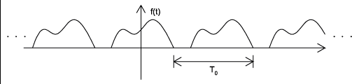
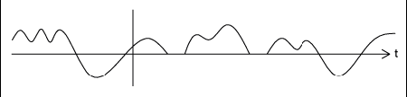
Examples
Still periodic?
Still an aperiodic signal?
周期与非周期性同样具有主观性！
Notes:
周期与非周期具有主观性

Slide 7
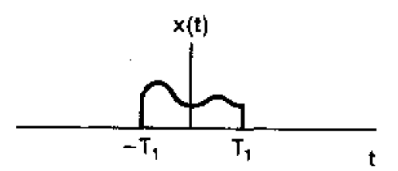

Fourier Transform Representation
From Fourier series to Fourier transform
The following signal, $x\left(t\right),$ is an aperiodic signal:

Slide 8

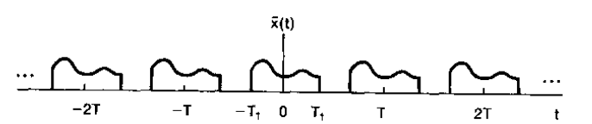
Fourier Transform Representation
From Fourier series to Fourier transform
Assume $x\left(t\right)$ is repeated for every period of $T (T→∞)$, as $\tilde{x}\left(t\right)$

Slide 9

Fourier Transform Representation
From Fourier series to Fourier transform
Fourier series representation:
$$\tilde{x}\left(t\right)=\sum_{k=−∞}^{∞}{a_{k}e^{jkω_{0}t}}$$
$$a_{k}=\frac{1}{T}\int_{−T/2}^{T/2}{\tilde{x}\left(t\right)e^{−jkω_{0}t}dt}$$

Slide 10

Fourier Transform Representation
From Fourier series to Fourier transform
In the time of [$−\frac{T}{2},\frac{T}{2}$], $\tilde{x}\left(t\right)=x(t)$
$$a_{k}=\frac{1}{T}\int_{−T/2}^{T/2}{\tilde{x}\left(t\right)e^{−jkω_{0}t}dt}$$
$$=\frac{1}{T}\int_{−T/2}^{T/2}{x\left(t\right)e^{−jkω_{0}t}dt}=\frac{1}{T}\int_{−∞}^{∞}{x\left(t\right)e^{−jkω_{0}t}dt}$$
$${Ta}_{k}=\int_{−∞}^{∞}{x\left(t\right)e^{−jkω_{0}t}dt}$$

Slide 11

Fourier Transform Representation
From Fourier series to Fourier transform
$${Ta}_{k}=\int_{−∞}^{∞}{x\left(t\right)e^{−jkω_{0}t}dt}$$
Define $X\left(jω\right)=\int_{−∞}^{∞}{x\left(t\right)e^{−jωt}dt}$
$${Ta}_{k}=X\left(jω\right)|_{ω=kω_{0}}=\int_{−∞}^{∞}{x\left(t\right)e^{−jωt}dt}|_{ω=kω_{0}}$$

Slide 12
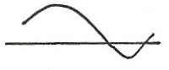



Fourier Transform Representation
From Fourier series to Fourier transform
$${Ta}_{k}=X{\left(jω\right)|}_{ω=kω_{0}}$$
$X\left(jω\right)$ is a continuous function related to $ω：$
$$X(jω)$$
$$ω$$

Slide 13

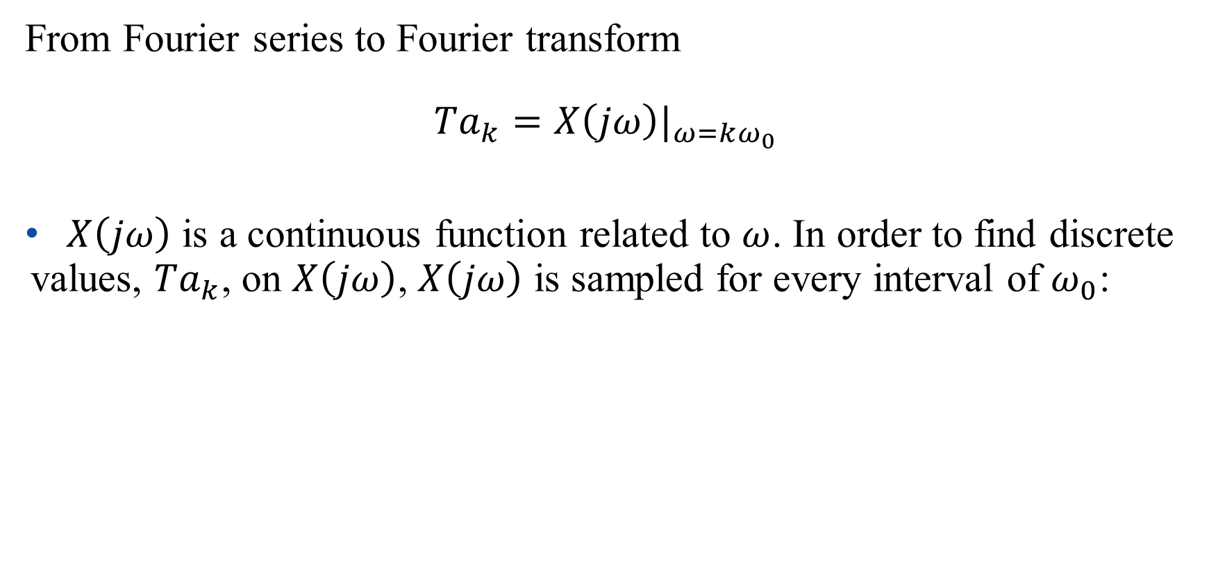


Fourier Transform Representation
From Fourier series to Fourier transform
$${Ta}_{k}=X{\left(jω\right)|}_{ω=kω_{0}}$$
$X\left(jω\right)$ is a continuous function related to $ω$. In order to find discrete values, ${Ta}_{k}$, on $X\left(jω\right)$, $X\left(jω\right)$ is sampled for every interval of $ω_{0}$:
$${Ta}_{k}=X{\left(jω\right)|}_{ω=kω_{0}}$$
$$ω_{0}$$
$$ω_{0}$$
$$ω$$

Slide 14


Fourier Transform Representation
From Fourier series to Fourier transform
$${Ta}_{k}=X{\left(jω\right)|}_{ω=kω_{0}}$$
$T↑, ω_{0}↓:$
$${Ta}_{k}=X{\left(jω\right)|}_{ω=kω_{0}}$$
$$ω_{0}$$
$$ω$$

Slide 15

Fourier Transform Representation
From Fourier series to Fourier transform
$${Ta}_{k}=X{\left(jω\right)|}_{ω=kω_{0}}$$
$T→∞,ω_{0}→0$:
$${Ta}_{k}=X{\left(jω\right)|}_{ω=kω_{0}}=X(jω)$$
$X(jω)$ is the envelope of ${Ta}_{k}$

Slide 16

Fourier Transform Representation
From Fourier series to Fourier transform
For aperiodic signals, Fourier series (spectral) can be approximated by a continuous function:
$$X\left(jω\right)=\int_{−∞}^{∞}{x\left(t\right)e^{−jωt}dt}$$

Slide 17

Fourier Transform Representation
$$\tilde{x}\left(t\right)=\sum_{k=−∞}^{∞}{a_{k}e^{jkω_{0}t}}, {Ta}_{k}=X{\left(jω\right)|}_{ω=kω_{0}}$$
$$\tilde{x}\left(t\right)=\sum_{k=−∞}^{∞}{{\frac{1}{T}X(jkω_{0})e}^{jkω_{0}t}}$$
$$=\frac{1}{2π}\sum_{k=−∞}^{∞}{X{ (jkω_{0})e}^{jkω_{0}t}}ω_{0}$$

Slide 18

Fourier Transform Representation
$$\tilde{x}\left(t\right)=\frac{1}{2π}\sum_{k=−∞}^{∞}{X{ (jkω_{0})e}^{jkω_{0}t}}ω_{0}$$
In the time of [$−\frac{T}{2},\frac{T}{2}$] ($T→∞$: [$−∞,∞$] ), $\tilde{x}\left(t\right)=x(t)$
$$x\left(t\right)=\frac{1}{2π}\sum_{k=−∞}^{∞}{X{ (jkω_{0})e}^{jkω_{0}t}}ω_{0}$$

Slide 19
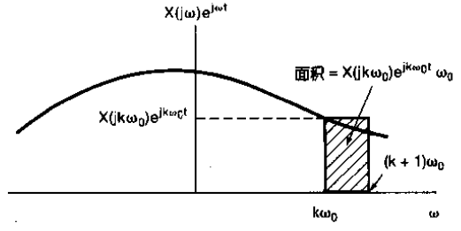

Fourier Transform Representation
$$x\left(t\right)=\frac{1}{2π}\sum_{k=−∞}^{∞}{X{ (jkω_{0})e}^{jkω_{0}t}}ω_{0}$$
$$x\left(t\right)=\frac{1}{2π}\int_{−∞}^{∞}{X\left(jω\right)e^{jωt}dω}$$

Slide 20

Fourier Transform Representation
Fourier transform (spectral) 傅里叶变换:
$$X\left(jω\right)=\int_{−∞}^{∞}{x\left(t\right)e^{−jωt}dt}$$
Inverse Fourier transform (signal representation) 傅里叶逆变换:
$$x\left(t\right)=\frac{1}{2π}\int_{−∞}^{∞}{X\left(jω\right)e^{jωt}dω}$$

Slide 21
Lecture 4, 5: 傅里叶级数与傅里叶变换
时域连续，周期与非周期信号对应频域特点：
Periodic in time domain $↔$ Discrete in frequency domain
Aperiodic in time domain $↔$ Continuous in frequency domain

Slide 22
Outline: Lecture 5: Continuous-time Fourier Transform
Continuous-time Fourier Transform
Fourier Transform Representation
Convergence Issue
Fourier Transform of Periodic Signal
Examples
Fourier Transform Properties

Slide 23
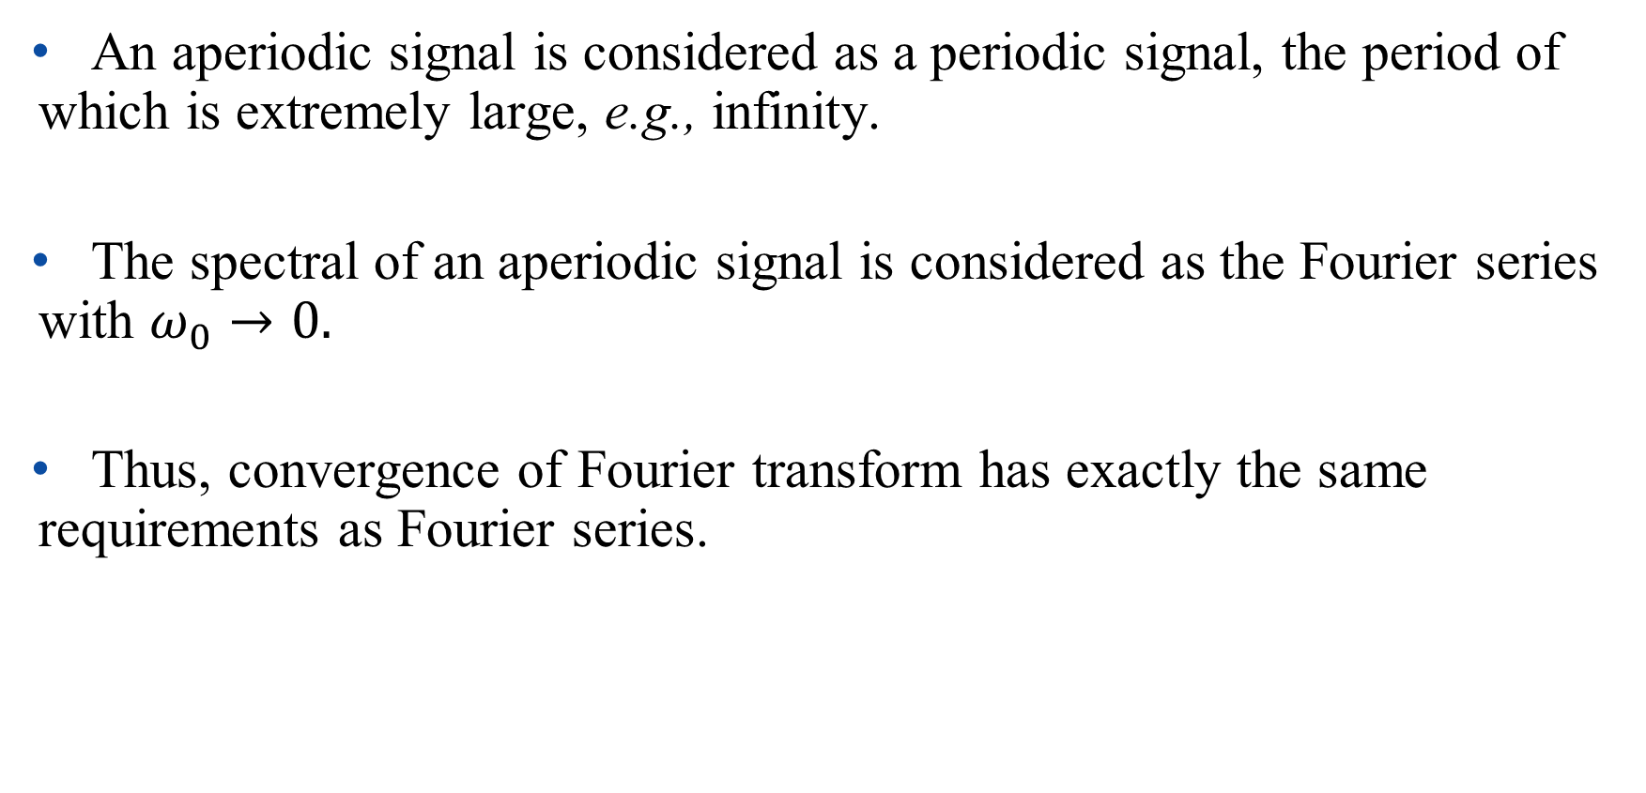
Convergence Issue
An aperiodic signal is considered as a periodic signal, the period of which is extremely large, e.g., infinity.
The spectral of an aperiodic signal is considered as the Fourier series with $ω_{0}→0.$
Thus, convergence of Fourier transform has exactly the same requirements as Fourier series.

Slide 24
Convergence Issue
A signal can be represented by Fourier transform, if it has finite energy:

Slide 25
Convergence Issue
Dirichlet’s condition
A signal can be represented by Fourier transform, if
(1) it is absolutely integrable,
(2) it has finite number of maxima & minima
(3) it has finite number of discontinuities

Slide 26
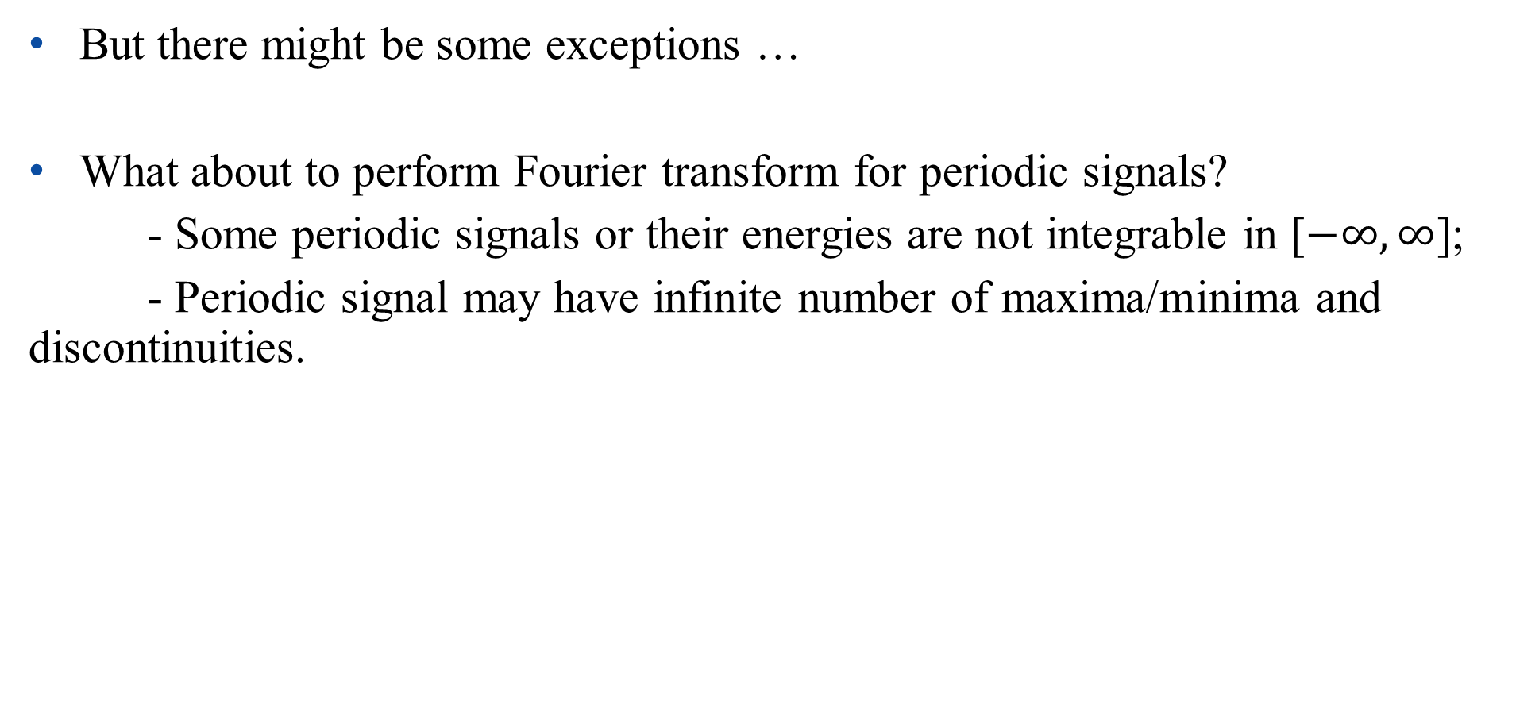
Convergence Issue
But there might be some exceptions …
What about to perform Fourier transform for periodic signals?
- Some periodic signals or their energies are not integrable in [$−∞,∞$];
- Periodic signal may have infinite number of maxima/minima and discontinuities.

Slide 27
Outline: Lecture 5: Continuous-time Fourier Transform
Continuous-time Fourier Transform
Fourier Transform Representation
Convergence Issue
Fourier Transform of Periodic Signal
Examples
Fourier Transform Properties

Slide 28

Fourier Transform of Periodic Signal
For a periodic signal, we have the Fourier series representation:
$$x\left(t\right)=\sum_{k=−∞}^{∞}{a_{k}e^{jkω_{0}t}}$$
Let us firstly consider the Fourier transform for a complex exponential: $e^{jkω_{0}t}$.

Slide 29
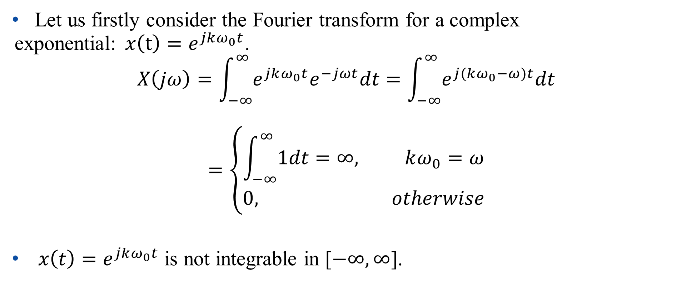
Fourier Transform of Periodic Signal
Let us firstly consider the Fourier transform for a complex exponential:$x\left(t\right)=e^{jkω_{0}t}$.
$$X\left(jω\right)=\int_{−∞}^{∞}{{e^{jkω_{0}t}e}^{−jωt}dt}=\int_{−∞}^{∞}{e^{j(kω_{0}−ω)t}dt}$$
$$=\left\{\begin{aligned}\int_{−∞}^{∞}{1dt}=∞, kω_{0}=ω \\ 0, otherwise\end{aligned}\right.$$
${x\left(t\right)=e}^{jkω_{0}t}$ is not integrable in [$−∞,∞$].

Slide 30

Fourier Transform of Periodic Signal
Fourier transform of a impulse function with a time shift of $t_{0}$:
$$x\left(t\right)=δ(t−t_{0})$$
$$X\left(jω\right)=\int_{−∞}^{∞}{δ(t−t_{0}) e^{−jωt}dt}=e^{−jωt_{0}}$$
Thus,
$$δ(t−t_{0})\underset{↔}{F}e^{−jωt_{0}}$$

Slide 31
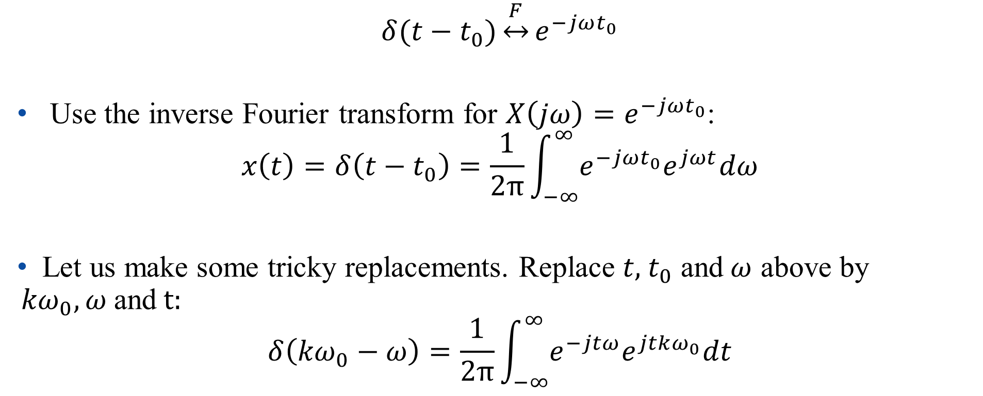
Fourier Transform of Periodic Signal
$$δ(t−t_{0})\underset{↔}{F}e^{−jωt_{0}}$$
Use the inverse Fourier transform for ${X\left(jω\right)=e}^{−jωt_{0}}$:
$$x\left(t\right)=δ\left(t−t_{0}\right)=\frac{1}{2π}\int_{−∞}^{∞}{e^{−jωt_{0}}e^{jωt}dω}$$
Let us make some tricky replacements. Replace $t, { t}_{0}$ and$ω$ above by ${kω}_{0},ω$and$t:$
$$δ\left({kω}_{0}−ω\right)=\frac{1}{2π}\int_{−∞}^{∞}{e^{−jtω}e^{jtkω_{0}}dt}$$

Slide 32
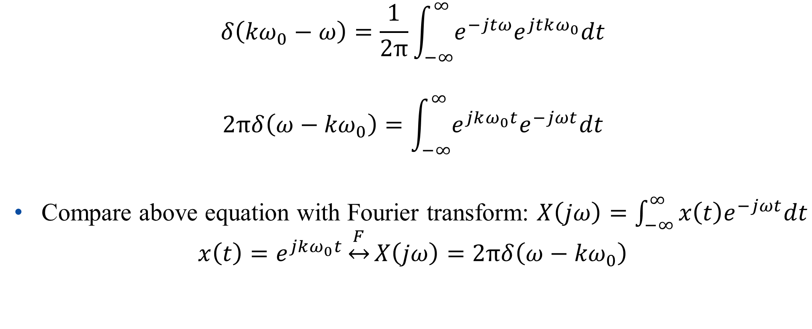
Fourier Transform of Periodic Signal
$$δ\left({kω}_{0}−ω\right)=\frac{1}{2π}\int_{−∞}^{∞}{e^{−jtω}e^{jtkω_{0}}dt}$$
$$2πδ\left(ω−{kω}_{0}\right)=\int_{−∞}^{∞}{e^{jkω_{0}t}e^{−jωt}dt}$$
Compare above equation with Fourier transform: $X\left(jω\right)=\int_{−∞}^{∞}{x\left(t\right)e^{−jωt}dt}$
$$x\left(t\right)=e^{jkω_{0}t}\underset{↔}{F}X\left(jω\right)=2πδ\left(ω−{kω}_{0}\right)$$

Slide 33
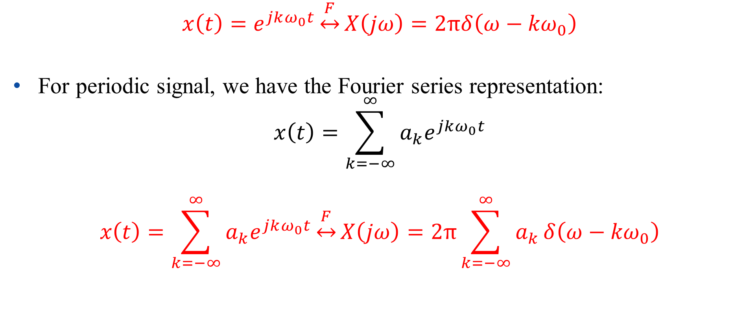
Fourier Transform of Periodic Signal
$x\left(t\right)=e^{jkω_{0}t}\underset{↔}{F}X\left(jω\right)=2πδ\left(ω−{kω}_{0}\right)$
For periodic signal, we have the Fourier series representation:
$$x\left(t\right)=\sum_{k=−∞}^{∞}{a_{k}e^{jkω_{0}t}}$$
$$x\left(t\right)=\sum_{k=−∞}^{∞}{a_{k}e^{jkω_{0}t}}\underset{↔}{F}X\left(jω\right)=2π\sum_{k=−∞}^{∞}{a_{k}}δ\left(ω−{kω}_{0}\right)$$

Slide 34
Fourier Transform of Periodic Signal
Fourier transform can be performed for periodic signals by using impulse function. The spectral is the same as Fourier series.
In such a case, we have a unified framework of Fourier transform for both periodic and aperiodic signals.

Slide 35
Outline: Lecture 5: Continuous-time Fourier Transform
Continuous-time Fourier Transform
Fourier Transform Representation
Convergence Issue
Fourier Transform of Periodic Signal
Examples
Fourier Transform Properties

Slide 36

Examples
Example 4.7, p.211 of textbook
Find the spectral (Fourier transform) for the following signals: $x\left(t\right)=sinω_{0}t$ and $x\left(t\right)=cosω_{0}t$.

Slide 37
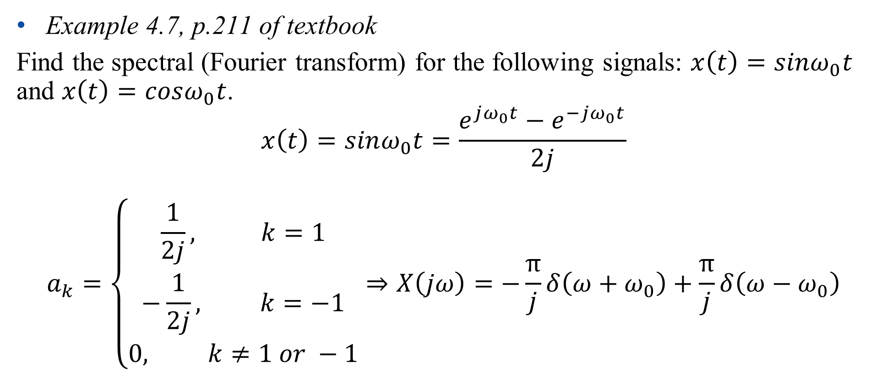
Examples
Example 4.7, p.211 of textbook
Find the spectral (Fourier transform) for the following signals: $x\left(t\right)=sinω_{0}t$ and $x\left(t\right)=cosω_{0}t$.
$$x\left(t\right)=sinω_{0}t=\frac{e^{jω_{0}t}−e^{−jω_{0}t}}{2j}$$
$$a_{k}=\left\{\begin{aligned}\frac{1}{2j}, k=1 \\ −\frac{1}{2j}, k=−1 \\ 0, k≠1 or −1\end{aligned}\right.⇒X\left(jω\right)=−\frac{π}{j}δ\left(ω+ω_{0}\right)+\frac{π}{j}δ\left(ω−ω_{0}\right)$$

Slide 38
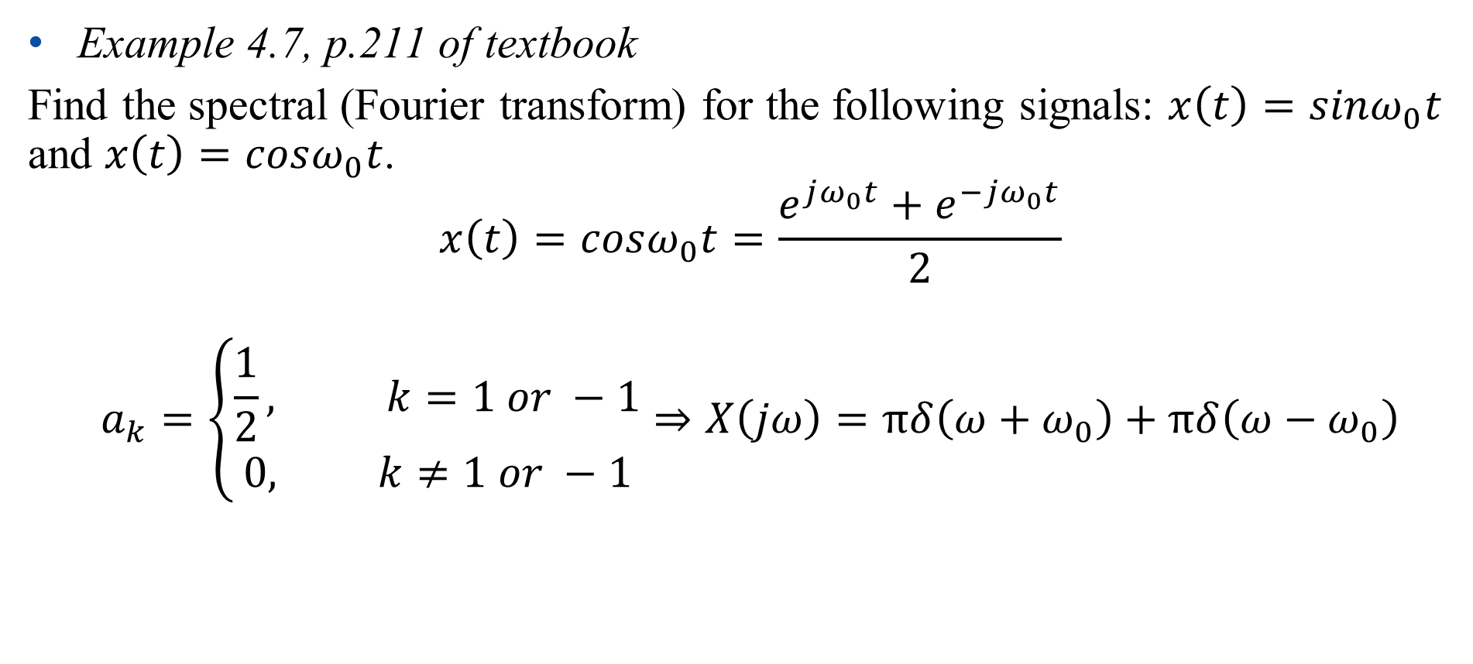
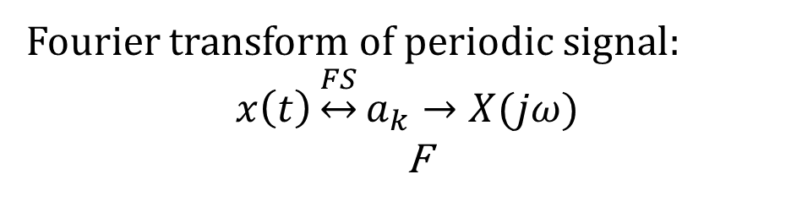
Examples
Example 4.7, p.211 of textbook
Find the spectral (Fourier transform) for the following signals: $x\left(t\right)=sinω_{0}t$ and $x\left(t\right)=cosω_{0}t$.
$$x\left(t\right)=cosω_{0}t=\frac{e^{jω_{0}t}+e^{−jω_{0}t}}{2}$$
$$a_{k}=\left\{\begin{aligned}\frac{1}{2}, k=1 or −1 \\ 0, k≠1 or −1\end{aligned}\right.⇒X\left(jω\right)=πδ\left(ω+ω_{0}\right)+πδ\left(ω−ω_{0}\right)$$
Fourier transform of periodic signal:
$$x\left(t\right)\underset{↔}{FS}a_{k}→X(jω)$$
F

Slide 39
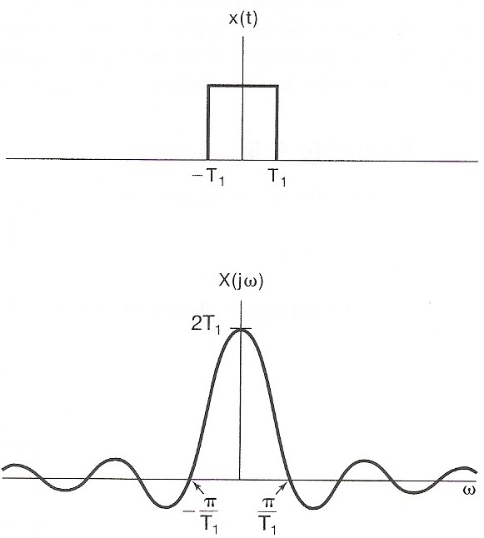
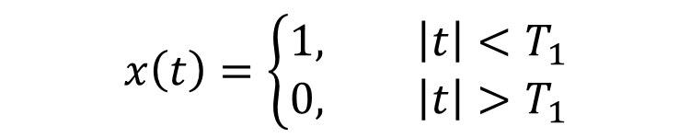
Examples
Example 4.4, p.208 of textbook
Find the spectral (Fourier transform) for the following signal:
$$x\left(t\right)=\left\{\begin{aligned}1, \left|t\right|<T_{1} \\ 0, \left|t\right|>T_{1}\end{aligned}\right.$$

Slide 40

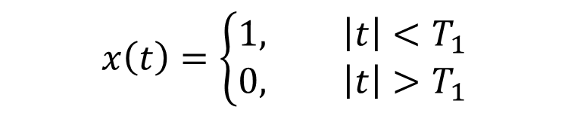
Examples
Example 4.4, p.208 of textbook
Find the spectral (Fourier transform) for the following signal:
$$X\left(jω\right)=\int_{−∞}^{∞}{x\left(t\right)e^{−jωt}dt}=\int_{−T_{1}}^{T_{1}}{e^{−jωt}dt}$$
$$=−\frac{1}{jω}e^{−jωT_{1}}−e^{jωT_{1}}=\frac{2sinωT_{1}}{ω}$$
$$x\left(t\right)=\left\{\begin{aligned}1, \left|t\right|<T_{1} \\ 0, \left|t\right|>T_{1}\end{aligned}\right.$$

Slide 41
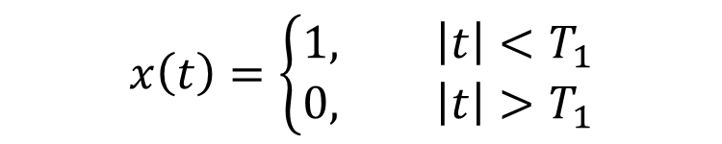
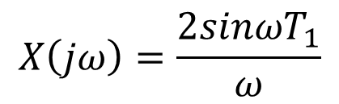
Examples
Example 4.4, p.208 of textbook
Find the spectral (Fourier transform) for the following signal:
$$x\left(t\right)=\left\{\begin{aligned}1, \left|t\right|<T_{1} \\ 0, \left|t\right|>T_{1}\end{aligned}\right.$$
$$X\left(jω\right)=\frac{2sinωT_{1}}{ω}$$

Slide 42
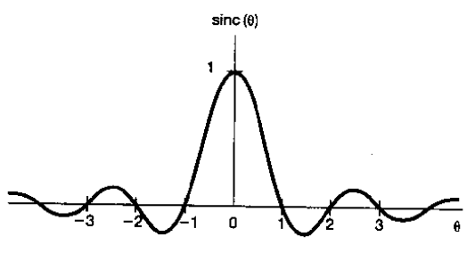

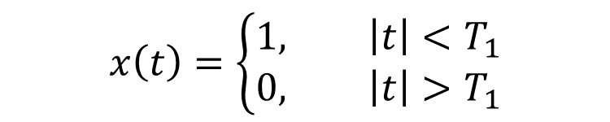
Examples
Example 4.4, p.208 of textbook
Find the spectral (Fourier transform) for the following signal:
Giving the definition of sinc function: $sinc\left(θ\right)=\frac{sinπθ}{πθ}$
$$x\left(t\right)=\left\{\begin{aligned}1, \left|t\right|<T_{1} \\ 0, \left|t\right|>T_{1}\end{aligned}\right.$$

Slide 43

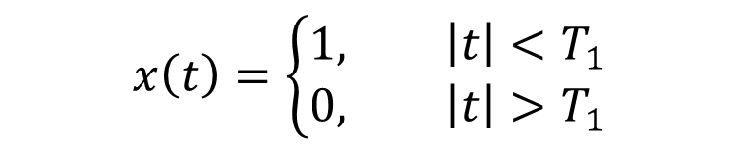
Examples
Example 4.4, p.208 of textbook
Find the spectral (Fourier transform) for the following signal:
$$X\left(jω\right)=\frac{2sinωT_{1}}{ω}=2T_{1}\frac{sinπ\frac{ωT_{1}}{π}}{π\frac{ωT_{1}}{π}}=2T_{1}sinc(\frac{ωT_{1}}{π})$$
$$x\left(t\right)=\left\{\begin{aligned}1, \left|t\right|<T_{1} \\ 0, \left|t\right|>T_{1}\end{aligned}\right.$$

Slide 44
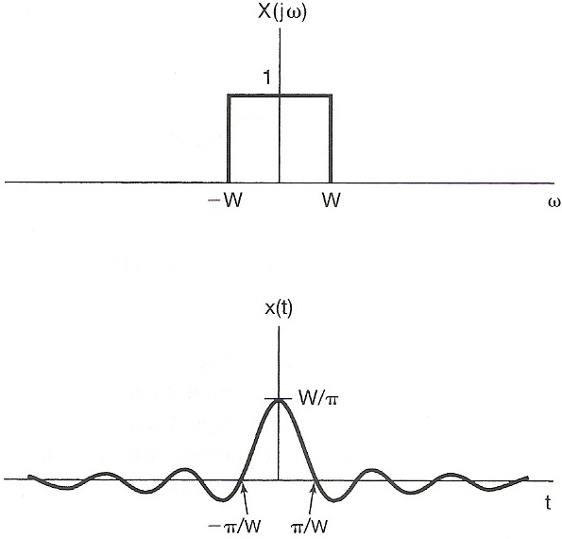
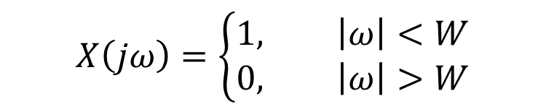
Examples
Example 4.5, p.209 of textbook
Find the signal function in time domain for the following signal:
$$X\left(jω\right)=\left\{\begin{aligned}1, \left|ω\right|<W \\ 0, \left|ω\right|>W\end{aligned}\right.$$

Slide 45
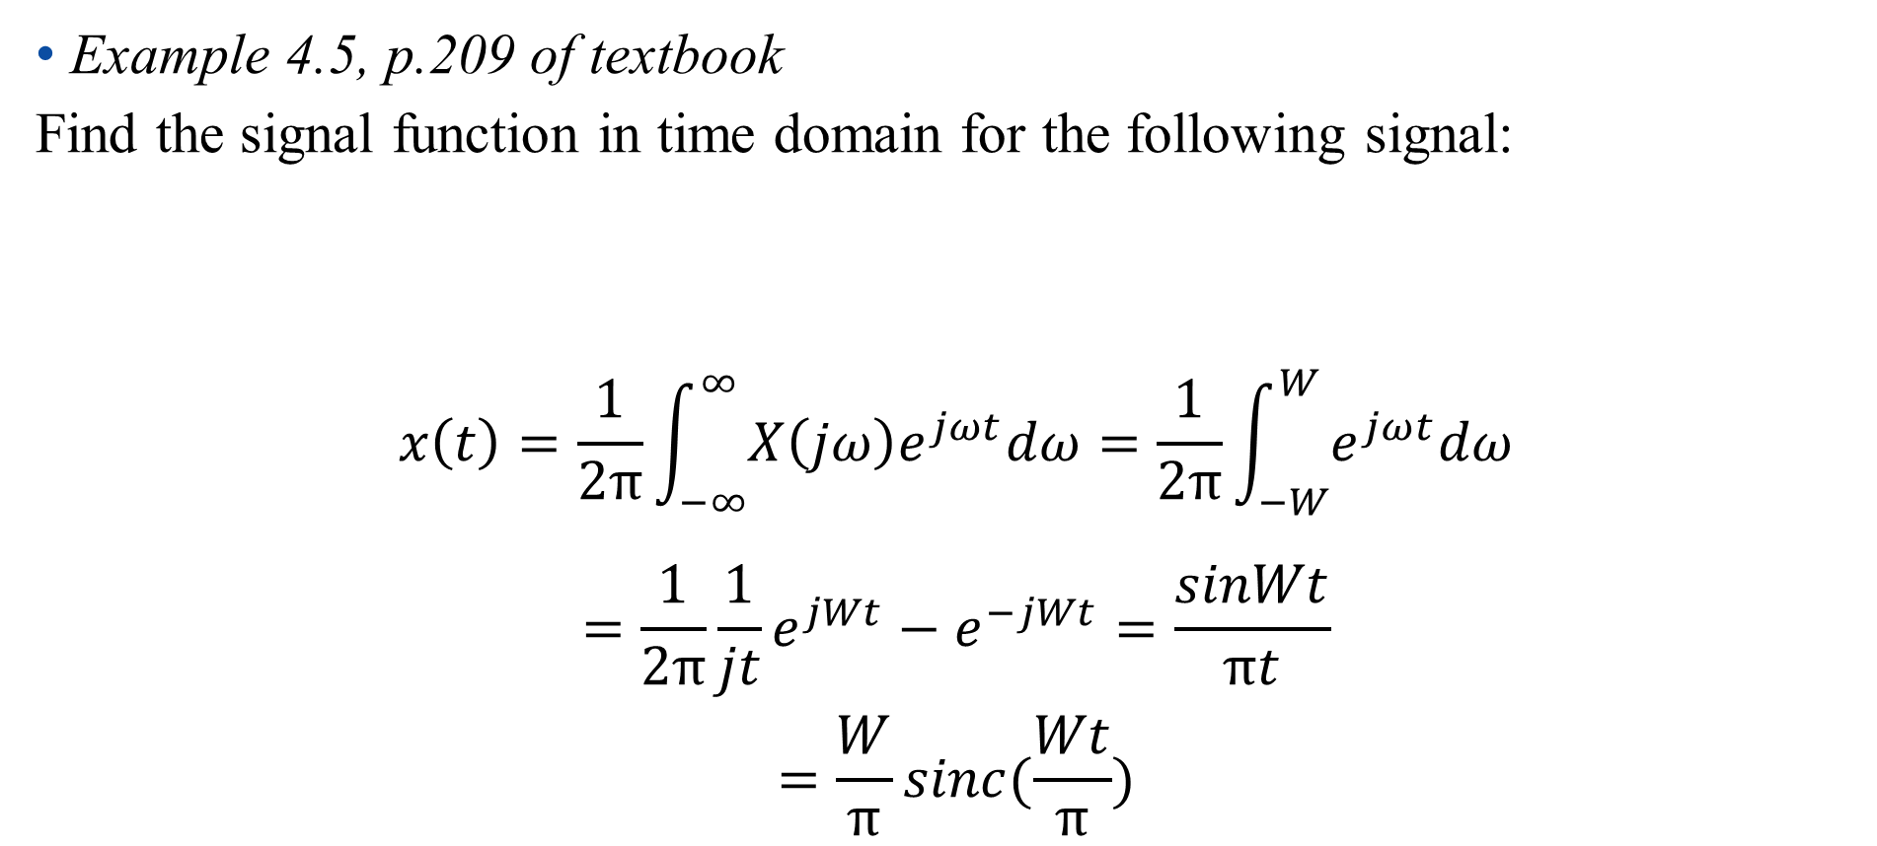
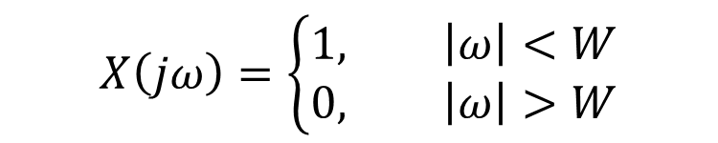
Examples
Example 4.5, p.209 of textbook
Find the signal function in time domain for the following signal:
$$x\left(t\right)=\frac{1}{2π}\int_{−∞}^{∞}{X\left(jω\right)e^{jωt}dω}=\frac{1}{2π}\int_{−W}^{W}{e^{jωt}dω}$$
$$=\frac{1}{2π}\frac{1}{jt}e^{jWt}−e^{−jWt}=\frac{sinWt}{πt}$$
$$=\frac{W}{π}sinc(\frac{Wt}{π})$$
$$X\left(jω\right)=\left\{\begin{aligned}1, \left|ω\right|<W \\ 0, \left|ω\right|>W\end{aligned}\right.$$

Slide 46

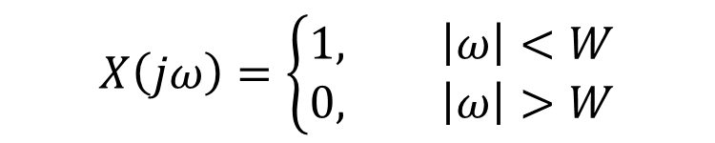
Examples
Example 4.5, p.209 of textbook
Find the signal function in time domain for the following signal:
$$X\left(jω\right)=\left\{\begin{aligned}1, \left|ω\right|<W \\ 0, \left|ω\right|>W\end{aligned}\right.$$
$x\left(t\right)=$ $\frac{sinWt}{πt}$

Slide 47
Outline: Lecture 5: Continuous-time Fourier Transform
Continuous-time Fourier Transform
Fourier Transform Representation
Convergence Issue
Fourier Transform of Periodic Signal
Examples
Fourier Transform Properties

Slide 48

Fourier Transform Properties
The following notation is used to indicate a pair of Fourier transform:
$$x(t)\underset{↔}{F}X(jω)$$

Slide 49

Fourier Transform Properties
Linearity
Assume :
$x\left(t\right)\underset{↔}{F}X(jω), y(t)\underset{↔}{F}Y(jω)$,
Then:
$ax\left(t\right)+by\left(t\right)\underset{↔}{F}aX(jω)+bY(jω)$

Slide 50
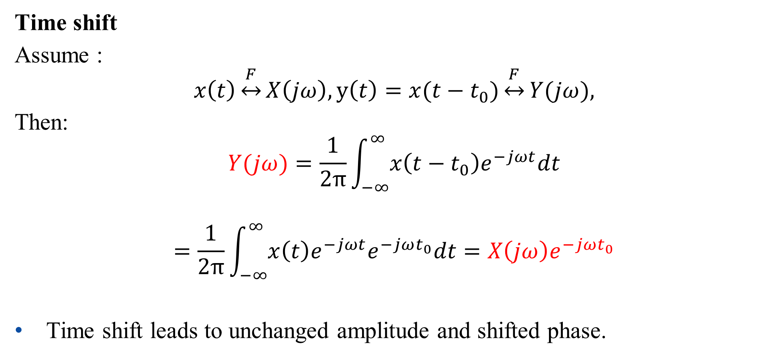
Fourier Transform Properties
Time shift
Assume :
$$x\left(t\right)\underset{↔}{F}X\left(jω\right), y\left(t\right)=x(t−t_{0})\underset{↔}{F}Y(jω)\text{,}$$
Then:
$$Y(jω)=\frac{1}{2π}\int_{−∞}^{∞}{x\left(t−t_{0}\right)e^{−jωt}dt}$$
$$=\frac{1}{2π}\int_{−∞}^{∞}{x\left(t\right)e^{−jωt}e^{−jωt_{0}}dt}=X\left(jω\right)e^{−jωt_{0}}$$
Time shift leads to unchanged amplitude and shifted phase.

Slide 51

Fourier Transform Properties
Conjugation
Assume:
$$x\left(t\right)\underset{↔}{F}X\left(jω\right)$$
Then:
$$x\left(t\right)=\frac{1}{2π}\int_{−∞}^{∞}{X\left(jω\right)e^{jωt}dω}$$
$$x^{∗}\left(t\right)=\frac{1}{2π}\int_{−∞}^{∞}{X^{∗}\left(jω\right){(e^{jωt})}^{∗}dω}=\frac{1}{2π}\int_{−∞}^{∞}{X^{∗}\left(jω\right)e^{−jωt}dω}=\frac{1}{2π}\int_{−∞}^{∞}{X^{∗}\left(−jω\right)e^{jωt}dω}$$
$$x^{∗}(t)\underset{↔}{F}X^{∗}\left(−jω\right)$$

Slide 52

Fourier Transform Properties
Conjugation
Even/Odd property
$$x\left(t\right)\underset{↔}{F}X\left(jω\right),x^{∗}(t)\underset{↔}{F}X^{∗}\left(−jω\right)$$
If $x\left(t\right)$ is real ($x\left(t\right)=x^{∗}(t)$):
$$X\left(jω\right)=X^{∗}\left(−jω\right)$$

Slide 53
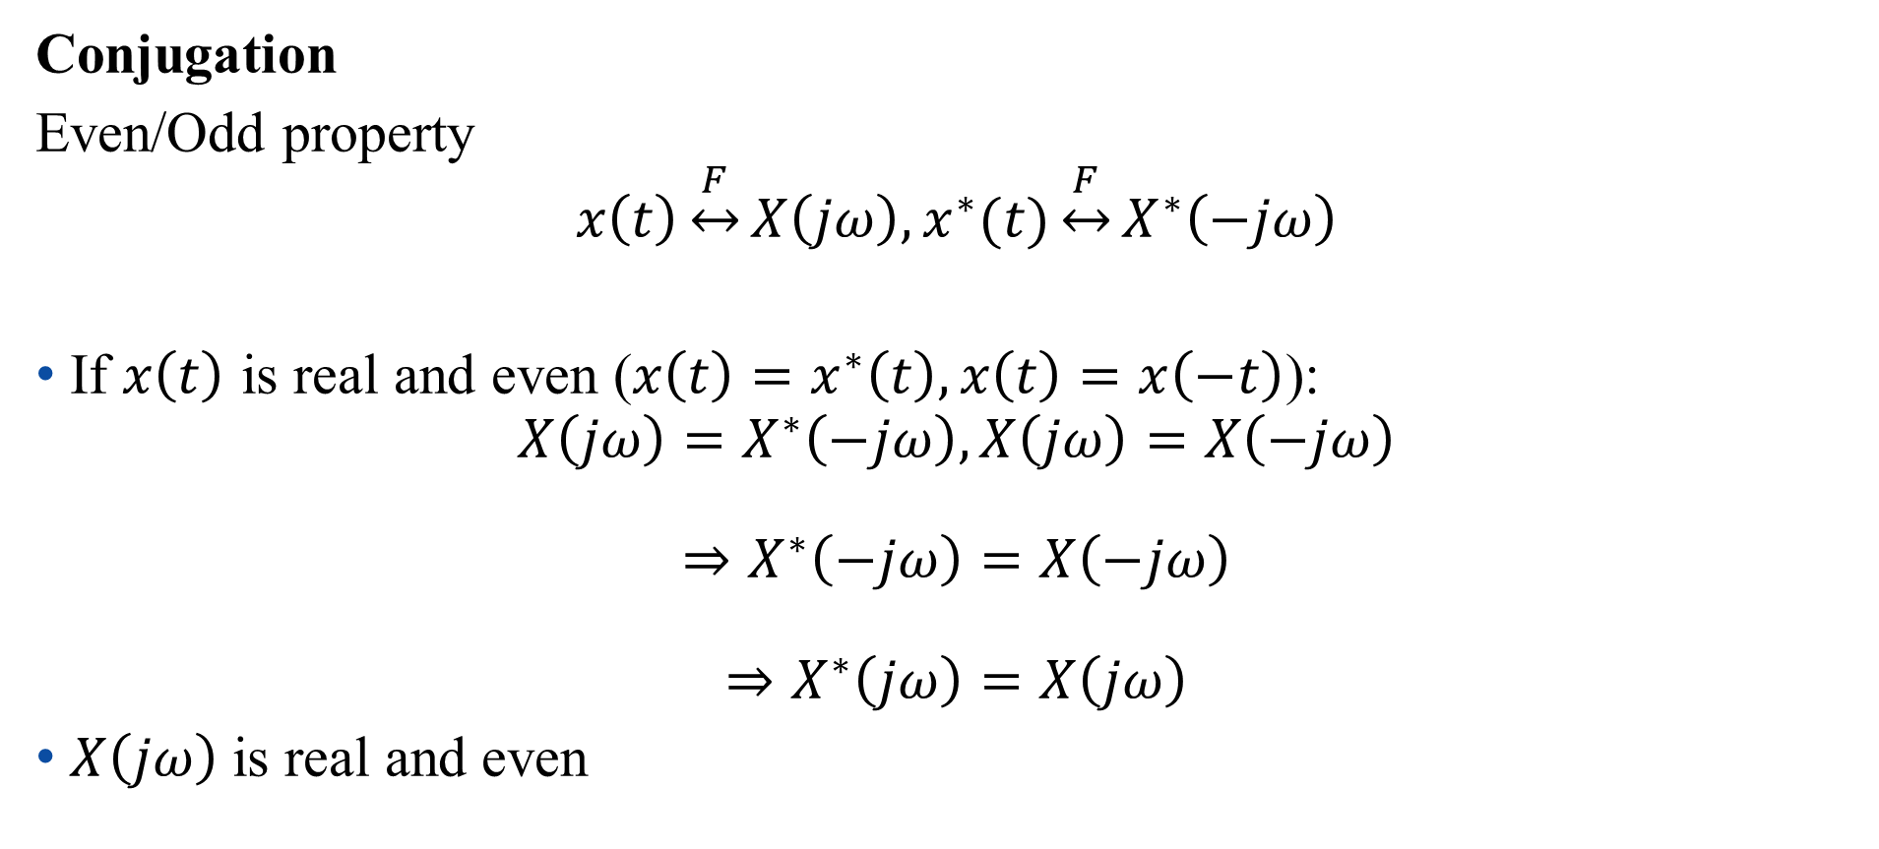
Fourier Transform Properties
Conjugation
Even/Odd property
$$x\left(t\right)\underset{↔}{F}X\left(jω\right),x^{∗}(t)\underset{↔}{F}X^{∗}\left(−jω\right)$$
If $x\left(t\right)$ is real and even ($x\left(t\right)=x^{∗}\left(t\right),x\left(t\right)=x\left(−t\right)$):
$$X\left(jω\right)=X^{∗}\left(−jω\right),X\left(jω\right)=X\left(−jω\right)$$
$$⇒X^{∗}\left(−jω\right)=X\left(−jω\right)$$
$$⇒X^{∗}\left(jω\right)=X\left(jω\right)$$
$X\left(jω\right)$is real and even

Slide 54

Fourier Transform Properties
Conjugation
Even/Odd property
$$x\left(t\right)\underset{↔}{F}X\left(jω\right),x^{∗}(t)\underset{↔}{F}X^{∗}\left(−jω\right)$$
If $x\left(t\right)$ is real and odd ($x\left(t\right)=x^{∗}\left(t\right),x\left(t\right)=−x\left(−t\right)$):
$$X\left(jω\right)=X^{∗}\left(−jω\right),X\left(jω\right)=−X\left(−jω\right)$$
$$⇒X^{∗}\left(−jω\right)=−X\left(−jω\right)$$
$$⇒X^{∗}\left(jω\right)=−X\left(jω\right)$$
$X\left(jω\right)$is imaginary and odd

Slide 55

Fourier Transform Properties
Conjugation
Any signal can be discomposed into a sum of an even and an odd
$${Ev\left\{x\left(t\right)\right\}=x}_{1}\left(t\right)=\frac{1}{2}\left[x\left(t\right)+x\left(−t\right)\right]$$
$$Od\left\{x\left(t\right)\right\}=x_{2}(t)=\frac{1}{2}[x(t)−x(−t)]$$
If $x\left(t\right)$ is real:
$$Ev\left\{x\left(t\right)\right\} \underset{↔}{F}ℝ\{X\left(jω\right)\}$$
$$Od\left\{x\left(t\right)\right\} \underset{↔}{F}𝕀\{X\left(jω\right)\}$$

Slide 56

Fourier Transform Properties
Differentiation
Assume:
$$x\left(t\right)\underset{↔}{F}X\left(jω\right)$$
Then:
$$\frac{dx(t)}{dt}=\frac{d(\frac{1}{2π}\int_{−∞}^{∞}{X\left(jω\right)e^{jωt}dω})}{dt}$$
$$=\frac{1}{2π}\int_{−∞}^{∞}{jωX\left(jω\right)e^{jωt}dω}$$
$$\frac{dx(t)}{dt}\underset{↔}{F}jωX\left(jω\right)$$

Slide 57







Fourier Transform Properties
Differentiation
$$\frac{dx(t)}{dt}\underset{↔}{F}jωX\left(jω\right)$$
$$\left|ω\right|$$
$$\left|X(jω)\right|$$
$$\left|jω⋅X(jω)\right|=\left|ω\right|⋅\left|X(jω)\right|$$
$$\left|ω\right|\left|X(jω)\right|$$
Enhancing higher frequencies
De-emphasizing lower frequencies
Deleting DC term ( =0 for ω=0)
$$ω$$

Slide 58

Fourier Transform Properties
Integration
Assume:
$$x\left(t\right)\underset{↔}{F}X\left(jω\right)$$
Then:
$$\int_{−∞}^{t}{x\left(τ\right)dτ}\underset{↔}{F}\frac{X\left(jω\right)}{jω}+πX(0)δ(ω)$$

Slide 59





Fourier Transform Properties
Integration
$$\int_{−∞}^{t}{x\left(τ\right)dτ}\underset{↔}{F}\frac{X\left(jω\right)}{jω}+πX(0)δ(ω)$$
$$\left|\frac{1}{jω}\right|⋅\left|X(jω)\right|=\left|\frac{1}{ω}\right|⋅\left|X(jω)\right|$$
$$\left|\frac{1}{ω}\right|$$
$$X(jω)$$
Enhancing lower frequencies
De-emphasizing higher frequencies (smoothing effect)
Undefined for ω=0
$$ω$$

Slide 60

Fourier Transform Properties
Time/frequency scaling
Assume :
$$x\left(t\right)\underset{↔}{F}X\left(jω\right), y\left(t\right)=x(at)\underset{↔}{F}Y\left(jω\right)$$
Then:
$$Y\left(jω\right)=\int_{−∞}^{∞}{x\left(at\right)e^{−jωt}dt}=\int_{−∞}^{∞}{x\left(τ\right)e^{−jω\frac{τ}{a}}d\frac{τ}{a}}$$
$$=\frac{1}{|a|}\int_{−∞}^{∞}{x\left(τ\right)e^{−j\frac{ω}{a}τ}dτ}=\frac{1}{|a|}X\left(\frac{jω}{a}\right)$$
$$x(at) \underset{↔}{F}\frac{1}{|a|}X\left(\frac{jω}{a}\right)$$

Slide 61



Fourier Transform Properties
Time/frequency scaling
$$x(at) \underset{↔}{F}\frac{1}{|a|}X\left(\frac{jω}{a}\right)$$
Inverse relationship between signal “width” in time/frequency domains:
Example 4.5, p.209 of textbook
$x\left(t\right)=$ $\frac{sinWt}{πt}$
$$X\left(jω\right)=\left\{\begin{aligned}1, \left|ω\right|<W \\ 0, \left|ω\right|>W\end{aligned}\right.$$

Slide 62


Fourier Transform Properties
Time/frequency scaling
$$x(at) \underset{↔}{F}\frac{1}{|a|}X\left(\frac{jω}{a}\right)$$
Assume $W_{1}>W_{2}>W_{3}$:

Slide 63

Fourier Transform Properties
Duality
Time/frequency domains are kind of “symmetric” except for a sign change (and a factor of 2π)
Fourier transform (spectral):
$$X\left(jω\right)=\int_{−∞}^{∞}{x\left(t\right)e^{−jωt}dt}$$
Inverse Fourier transform (signal representation):
$$x\left(t\right)=\frac{1}{2π}\int_{−∞}^{∞}{X\left(jω\right)e^{jωt}dω}$$

Slide 64

Fourier Transform Properties
Duality
Time/frequency domains are kind of “symmetric” except for a sign change (and a factor of 2π)
Example 4.4, p.208 of textbook:
Example 4.5, p.209 of textbook:

Slide 65

Fourier Transform Properties
Duality
If x(t) has a Fourier Transform X(jω), then if we form a new function of time that has the functional form of the transform, X(t), it will have a Fourier Transform x(ω) that has the functional form of the original time function (but is a function of frequency).
Mathematically, we can write:
$$x\left(t\right)\underset{↔}{F}X\left(jω\right)=X^{′}\left(ω\right)$$
$$X^{′}(t)\underset{↔}{F}2πx(−ω)$$

Slide 66

Fourier Transform Properties
Duality
$$x\left(t\right)\underset{↔}{F}X\left(jω\right)=X^{′}(ω)$$
$$X^{′}(t)\underset{↔}{F}2πx(−jω)$$
Proof:
$$x\left(t\right)=\frac{1}{2π}\int_{−∞}^{∞}{X^{′}\left(ω\right)e^{jωt}dω}$$
$$2πx\left(t\right)=\int_{−∞}^{∞}{X^{′}\left(ω\right)e^{jωt}dω}$$
Simply replace $t$ and $ω$ by $−ω$ and t:
$$2πx\left(−ω\right)=\int_{−∞}^{∞}{X^{′}\left(t\right)e^{−jωt}dt}$$

Slide 67

Fourier Transform Properties
Duality
Example: Given a pair of Fourier transform: $x\left(t\right)=\left\{\begin{aligned}1, \left|t\right|<T_{1} \\ 0, \left|t\right|>T_{1}\end{aligned}\underset{↔}{F}X\left(jω\right)=\frac{2sinωT_{1}}{ω} \right.$, find Fourier transform for $x\left(t\right)=$ $\frac{sinWt}{πt}$.

Slide 68

Fourier Transform Properties
Duality
$$x\left(t\right)\underset{↔}{F}X\left(jω\right)=X^{′}\left(ω\right)$$
$$X^{′}(t)\underset{↔}{F}2πx(−ω)$$
Example: Given a pair of Fourier transform: $x\left(t\right)=\left\{\begin{aligned}1, \left|t\right|<T_{1} \\ 0, \left|t\right|>T_{1}\end{aligned}\underset{↔}{F}X\left(jω\right)=\frac{2sinωT_{1}}{ω} \right.$, find Fourier transform for $x\left(t\right)=$ $\frac{sinWt}{πt}$.
$$\left\{\begin{aligned}1, \left|t\right|<T_{1} \\ 0, \left|t\right|>T_{1}\end{aligned}\underset{↔}{F}\frac{2sinωT_{1}}{ω} \right.$$
$$\frac{2sintT_{1}}{t}\underset{↔}{F}\left\{\begin{aligned}2π, \left|ω\right|<T_{1} \\ 0, \left|ω\right|>T_{1}\end{aligned}\right.$$

Slide 69

Fourier Transform Properties
Duality
Example: Given a pair of Fourier transform: $x\left(t\right)=\left\{\begin{aligned}1, \left|t\right|<T_{1} \\ 0, \left|t\right|>T_{1}\end{aligned}\underset{↔}{F}X\left(jω\right)=\frac{2sinωT_{1}}{ω} \right.$, find Fourier transform for $x\left(t\right)=$ $\frac{sinWt}{πt}$.
$$\frac{2sintT_{1}}{t}\underset{↔}{F}\left\{\begin{aligned}2π, \left|ω\right|<T_{1} \\ 0, \left|ω\right|>T_{1}\end{aligned}\right.$$
Replace $T_{1}$ by $W$:
$$\frac{2sinWt}{t}\underset{↔}{F}\left\{\begin{aligned}2π, \left|ω\right|<W \\ 0, \left|ω\right|>W\end{aligned}\right.$$
$$\frac{sinWt}{πt}\underset{↔}{F}\left\{\begin{aligned}1, \left|ω\right|<W \\ 0, \left|ω\right|>W\end{aligned}\right.$$

Slide 70

Fourier Transform Properties
Parseval’s relation
The integral of the square of a function is equal to the integral of the square of its Fourier transform.
$$\int_{−∞}^{∞}{{|x\left(t\right)|}^{2}dt}=\frac{1}{2π}\int_{−∞}^{∞}{{|X(jω)|}^{2}dω}$$

Slide 71

Fourier Transform Properties
Parseval’s relation
Proof:
$$\int_{−∞}^{∞}{{|x\left(t\right)|}^{2}dt}=\int_{−∞}^{∞}{x(t)x^{∗}(t)dt}$$
$$=\int_{−∞}^{∞}{x\left(t\right)[\frac{1}{2π}\int_{−∞}^{∞}{X^{∗}\left(jω\right)e^{−jωt}dω}] dt}$$
$$=\frac{1}{2π}\int_{−∞}^{∞}{X^{∗}\left(jω\right)[\int_{−∞}^{∞}{x\left(t\right)e^{−jωt}dt}] dω}$$
$$=\frac{1}{2π}\int_{−∞}^{∞}{X^{∗}\left(jω\right)X\left(jω\right)dω}=\frac{1}{2π}\int_{−∞}^{∞}{{|X(jω)|}^{2}dω}$$

Slide 72

Fourier Transform Properties
Convolution
Assume :
$$x\left(t\right)\underset{↔}{F}X\left(jω\right), h\left(t\right)\underset{↔}{F}H\left(jω\right)$$
Then:
$$x\left(t\right)∗h(t)\underset{↔}{F}X\left(jω\right)H\left(jω\right)$$
Proof: p223 of textbook

Slide 73




Fourier Transform Properties
Convolution
Response of LTI systems to exponential signal (Lecture 4)
$$y\left(t\right)=e^{jωt}∗h\left(t\right)=e^{jωt}\int_{−∞}^{∞}{h\left(τ\right)e^{−jωτ}dτ=e^{jωt}H(jω)}$$
$$h(t)$$
$$x\left(t\right)=e^{jωt}$$
$$y(t)$$
LTI

Slide 74

Fourier Transform Properties
Convolution
$$x\left(t\right)=\frac{1}{2π}\int_{−∞}^{∞}{X\left(jω\right)e^{jωt}dω}$$
$$\dot{=}\frac{1}{2π}\lim_{ω_{0}→0}{\sum_{k=−∞}^{∞}{X\left(jkω_{0}\right)e^{jkω_{0}t}ω_{0}} }$$
$$=\sum_{k=−∞}^{∞}{A_{k}e^{jkω_{0}t}}$$

Slide 75


Fourier Transform Properties
Convolution
$$y\left(t\right)=\sum_{k=−∞}^{∞}{A_{k}e^{jkω_{0}t}}∗h\left(t\right)=\sum_{k=−∞}^{∞}{A_{k}e^{jkω_{0}t}}H(jkω_{0})$$
$$=\frac{1}{2π}\lim_{ω_{0}→0}{\sum_{k=−∞}^{∞}{X\left(jkω_{0}\right)e^{jkω_{0}t}ω_{0}}H(jkω_{0}) }$$
$$=\frac{1}{2π}\int_{−∞}^{∞}{X\left(jω\right)H(jω)e^{jωt}dω}$$
$$x\left(t\right)=\sum_{k=−∞}^{∞}{A_{k}e^{jkω_{0}t}}$$
$$h(t)$$
$$y(t)$$
LTI

Slide 76

Fourier Transform Properties
Convolution
$$x\left(t\right)∗h(t)\underset{↔}{F}X\left(jω\right)H\left(jω\right)$$
Convolution in time domain leads to multiplication in frequency domain
Cascade of multiple systems implies product of these frequency response, independent of the order of the cascade
Application: filtering of signals

Slide 77



Fourier Transform Properties
Convolution
Ideal low-pass filter
$$H\left(jω\right)=\left\{\begin{aligned}1, |ω|≤ω_{c} \\ 0, \left|ω\right|>ω_{c}\end{aligned}\right.$$
$h\left(t\right)=$ $\frac{sinω_{c}t}{πt}$

Slide 78












Fourier Transform Properties
Convolution
Ideal low-pass filter
Assume $ω_{0}>ω_{c}$:
$$h\left(t\right)=\frac{sinω_{c}t}{πt}$$
$$x\left(t\right)=\frac{sinω_{0}t}{πt}$$
$$y(t)$$
LTI
Cut-off
$$X(jω)$$
$$Y(jω)$$
$$−ω_{0}$$
$$ω_{0}$$
$$−ω_{0}$$
$$ω_{0}$$
-$ω_{C}$
$$ω_{C}$$

Slide 79

Fourier Transform Properties
Multiplication
Assume :
$$s\left(t\right)\underset{↔}{F}S\left(jω\right), p\left(t\right)\underset{↔}{F}P\left(jω\right)$$
Then:
$$s\left(t\right)p\left(t\right)\underset{↔}{F}\frac{1}{2π}[S\left(jω\right)∗P\left(jω\right)]$$
Multiplication property is a dual property of convolution property.

Slide 80




Fourier Transform Properties
Multiplication -> Modulation
Example 4.21, p.229 of textbook
$$p\left(t\right)=cosω_{0}t\underset{↔}{F}$$
$$P\left(jω\right)=πδ\left(ω−ω_{0}\right)+πδ\left(ω+ω_{0}\right)$$
$$s\left(t\right)\underset{↔}{F}S\left(jω\right)$$

Slide 81

Fourier Transform Properties
Multiplication -> Modulation
Example 4.21, p.229 of textbook
$$s\left(t\right)p\left(t\right)\underset{↔}{F}\frac{1}{2π}[S\left(jω\right)∗P\left(jω\right)]$$
$$\frac{1}{2π}\left[S\left(jω\right)∗P\left(jω\right)\right]=\frac{1}{2π}\left[S\left(jω\right)∗πδ\left(ω−ω_{0}\right)+S\left(jω\right)∗πδ\left(ω+ω_{0}\right)\right]$$
$$=\frac{1}{2π}[\int_{−∞}^{∞}{S\left(ju\right)πδ\left(u−ω−ω_{0}\right)du+}\int_{−∞}^{∞}{S\left(ju\right)πδ\left(u−ω+ω_{0}\right)du}]$$
$$=\frac{1}{2}S\left(j(ω+ω_{0})\right)+\frac{1}{2}S\left(j(ω−ω_{0})\right)$$

Slide 82


Fourier Transform Properties
Multiplication -> Modulation
Example 4.21, p.229 of textbook
$\frac{1}{2π}[S\left(jω\right)∗P\left(jω\right)]$ generally has the shape (information) of $S\left(jω\right)$ and the frequency of $P\left(jω\right)$.

Slide 83

Fourier Transform Properties
Multiplication -> Demodulation
Example 4.22, p.230 of textbook
Recover $S\left(jω\right)$ from $R\left(jω\right)=\frac{1}{2π}[S\left(jω\right)∗P\left(jω\right)]$

Slide 84

Fourier Transform Properties
Multiplication -> Demodulation
Example 4.22, p.230 of textbook
$$r\left(t\right)p\left(t\right)\underset{↔}{F}\frac{1}{2π}[R\left(jω\right)∗P\left(jω\right)]$$
$$\frac{1}{2π}\left[R\left(jω\right)∗P\left(jω\right)\right]=\frac{1}{2π}\{\left[\frac{1}{2}S\left(j\left(ω+ω_{0}\right)\right)+\frac{1}{2}S\left(j\left(ω−ω_{0}\right)\right)\right]∗\left[πδ\left(ω−ω_{0}\right)+πδ\left(ω+ω_{0}\right)\right]\}$$
$$=\frac{1}{4}S\left(j\left(ω+2ω_{0}\right)\right)+\frac{1}{2}S\left(jω\right)+\frac{1}{4}S\left(j\left(ω−2ω_{0}\right)\right)$$

Slide 85



Fourier Transform Properties
Multiplication -> Demodulation
Example 4.22, p.230 of textbook
$S\left(jω\right)$ is recovered by putting $\frac{1}{2π}[R\left(jω\right)∗P\left(jω\right)]$ into a low-pass filter ($ω_{c}=ω_{1}$)
$$\frac{1}{2π}\left[R\left(jω\right)∗P\left(jω\right)\right]$$

Slide 86
Thank you for your listening!

